Slide 1
EMTH403
Mathematical Foundation for Computer Science

Slide 2
Lecture Outcomes
understand what are Euler path in a directed and undirected graph.
understand what are Euler circuit in a directed and undirected graph.

Slide 3
Euler Paths and Circuits
Necessary and Sufficient Conditions
A connected multigraph has a Euler circuit if and only if each of its vertices has an even degree.
A connected multigraph has a Euler path but not an Euler circuit if and only if it has exactly two vertices of odd degree.

Slide 4
Euler Paths and Circuits
a
b
Ques:- Does the graph above has an Euler path?
Sol:- Yes
(d, a, b,c, d, b.)
d
c

Slide 5
Euler Paths and Circuits
a
g
f
e
Ques:- Does the graph above has an Euler path?
Sol:- Yes
(b, a, g, f, e, d, c, g, b, c, f, d)
b
c
d

Slide 6
Euler Paths and Circuits
a
Ques:- Does the graph above has an Euler path?
Sol:- No
six vertices of odd degree
b
f
g
e
c
d

Slide 7
Euler Paths and Circuits
Ques:- Does the graph above has an Euler path?
Sol:- No

Slide 8
Euler Paths and Circuits
b
a
c
e
d
Ques:- Does the graph above has an Euler circuit or an Euler path?
Sol:- Since there are four vertices of odd degree (a, b, c, and e) and 4 > 2, this graph has neither an Euler circuit nor an Euler path.

Slide 9
Euler Paths and Circuits
a
b
e
d
c
Ques:- Does the graph above has an Euler circuit or an Euler path?
Sol:- Since there are two vertices of odd degree (a and d), this graph has no Euler circuit, but it does have an Euler path starting at a and ending at d. We can find such a path by inspection, One such path is a, e, c, e, b, e, d, b, a, c, d.

Slide 10
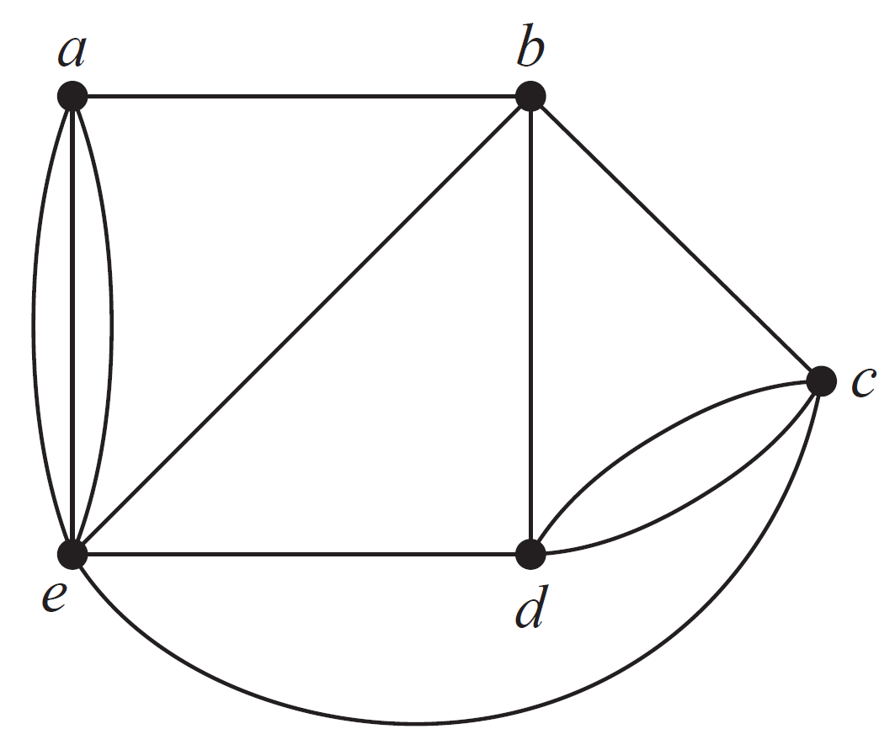
Euler Paths and Circuits
Sol:- All the vertex degrees are even, so there is an Euler circuit. We can find such a circuit by inspection, One such circuit is a, b, c, d, c, e, d, b, e, a, e, a.
.

Slide 11
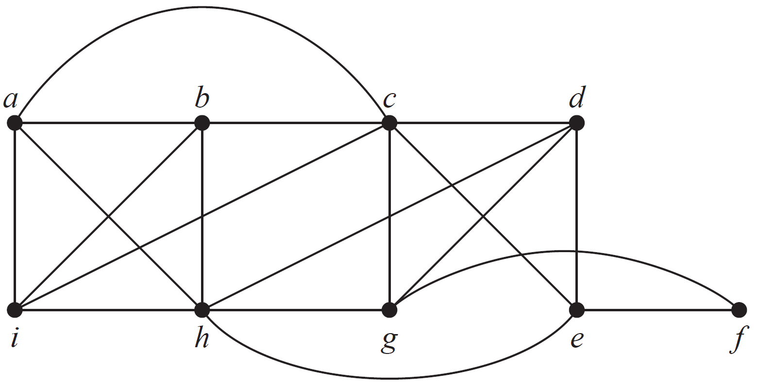
Euler Paths and Circuits
Sol:- All the vertex degrees are even, so there is an Euler circuit. We can find such a circuit by inspection, One such circuit is a, b, c, d, e, f, g, h, i, a, h, b, i, c, e, h, d, g, c, a.

Slide 12
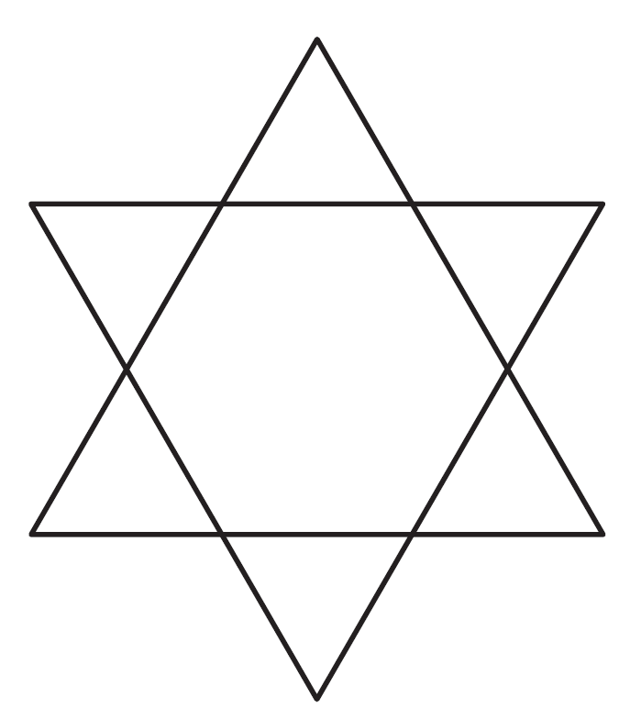
Euler Paths and Circuits
Ques:- Determine whether the picture shown can
be drawn with a pencil in a continuous motion without lifting
the pencil or retracing part of the picture.
Sol:- The graph in the current exercise has all vertices of even degree; therefore it has an Euler circuit and can be so traced.

Slide 13
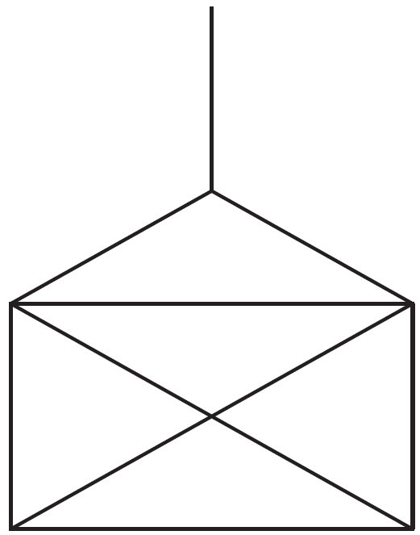
Euler Paths and Circuits
Ques:- Determine whether the picture shown can
be drawn with a pencil in a continuous motion without lifting
the pencil or retracing part of the picture.
Sol:- This graph has 4 vertices of odd degree; therefore it has no Euler path or circuit and cannot be so traced.

Slide 14
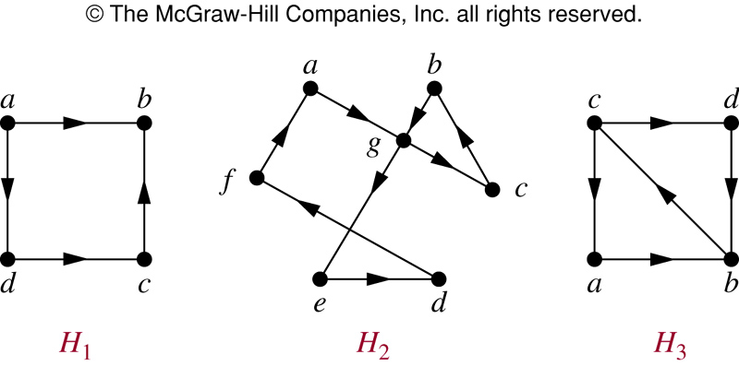
Euler Circuit in Directed Graphs
Ques:- Does the graph above has an Euler circuit?
Sol:- No

Slide 15
Euler Circuit in Directed Graphs
Ques:- Does the graph above has an Euler circuit?
Sol:- Yes (a, g, c, b, g, e, d, f, a)

Slide 16
Euler Circuit in Directed Graphs
Ques:- Does the graph above has an Euler circuit?
Sol:- No

Slide 17
Euler Path in Directed Graphs
Ques:- Does the graph above has an Euler path?
Sol:- Yes
(a, g, c, b, g, e, d, f, a)

Slide 18
Euler Path in Directed Graphs
Ques:- Does the graph above has an Euler path?
Sol:- Yes
(c, a, b, c, d, b)

Slide 19
Euler Paths and Circuits
Ques:- For which values of n do the graphs K_{n} have an Euler path but no Euler circuit?
Sol:- Clearly K₂ has an Euler path but no Euler circuit.

Slide 20
Euler Paths and Circuits
Ques:- For which values of n do the graphs K_{n} have an Euler path but no Euler circuit?
Sol:- For odd n > 2 there is an Euler circuit (since the degrees of all the vertices are n -1, which is even), whereas for even n > 2 there are at least 4 vertices of odd degree and hence no Euler path.

Slide 21
Euler Paths and Circuits
Ques:- For which values of n do the graphs K_{n} have an Euler path but no Euler circuit?
Sol:- Thus for no n other than 2 is there an Euler path but not an Euler circuit.

Slide 22
Euler Paths and Circuits
Ques:- For which values of n do the graph C_{n} have an Euler path but no Euler circuit?
Sol:- Since C_{n} has an Euler circuit for all n, there are no values of n meeting these conditions.

Slide 23
Euler Paths and Circuits
Ques:- For which values of n do the graph W_{n} have an Euler path but no Euler circuit?
Sol:- A wheel has at least 3 vertices of degree 3 (around the rim), so there can be no Euler path.

Slide 24
Euler Paths and Circuits
Ques:- For which values of n do the graph Q_{n} have an Euler path but no Euler circuit?
Sol:- The same argument applies here as applied in part (a). In more detail, Q₁ (which is the same as K₂ ) is the only cube with an Euler path but no Euler circuit, since for odd n > 1 there are too many vertices of odd degree, and for even n > 1 there is an Euler circuit.

